Slide 1

Department of Artificial Intelligence and Data Science
SKILL GAP DETECTION AND JOB FITMENT VIA SELECTION INSIGHT AND REJECTION REASONING
Mrs. V. DIVYA BHAVANI
ASSISTANT PROFESSOR
PRIYADARSHINI S (221801040)
SANDHYA J (221801044)
TANUSHRI G V S (221801055)

Slide 2
Problem Statement and Motivation
In today’s competitive job market, many students and job seekers struggle to understand whether their skills match industry expectations or specific job roles. Most candidates are unaware of the exact skills they lack, why their resumes get rejected, or how well they fit into different career paths. This confusion lowers confidence and affects employability.
To address these challenges, this project proposes an AI-driven system that analyzes resumes, identifies skill gaps, evaluates job fitment, and provides clear rejection reasons. Along with this, an AI Interviewer offers personalized interview preparation, creating a complete, student-focused solution to improve placement readiness and overall career outcomes.

Slide 3
Existing System
In today’s recruitment process, most companies use ATS tools that mainly rely on keyword matching to filter resumes.
Popular platforms like LinkedIn Talent Insights, Naukri Recruiter, Indeed Screening, Zoho Recruit, Workday, and Taleo focus on keywords but do not deeply assess real skills, identify gaps, provide job-fit scoring, or explain rejection reasons.
They also lack interview preparation features, leaving candidates unaware of what skills they miss or why their resume was rejected.

Slide 4
Objectives
The objective of this project is to build an AI-based system that helps candidates understand their skills, job suitability, and areas needing improvement. The system focuses on identifying skill gaps, predicting suitable roles, explaining rejection reasons, and generating interview questions for better preparation.
Key Objectives:
To identify missing skills for selected job roles.
To predict best-fit roles using similarity and ML models.
To provide clear rejection reasoning based on company requirements.
To generate personalized, role-specific interview questions.

Slide 5
Abstract
This project introduces an AI-driven system that improves career readiness by analyzing resumes and checking how well a candidate matches different job roles. Using NLP and machine learning, it extracts skills, identifies missing and matched skills, and predicts suitable roles through similarity scoring. It also provides clear rejection reasons by comparing selected and rejected resumes with company requirements. An integrated AI Interviewer generates role-specific and skill-based questions for personalized interview preparation. Overall, the system helps students and job seekers understand skill gaps, improve employability, and prepare effectively for industry expectations.

Slide 6
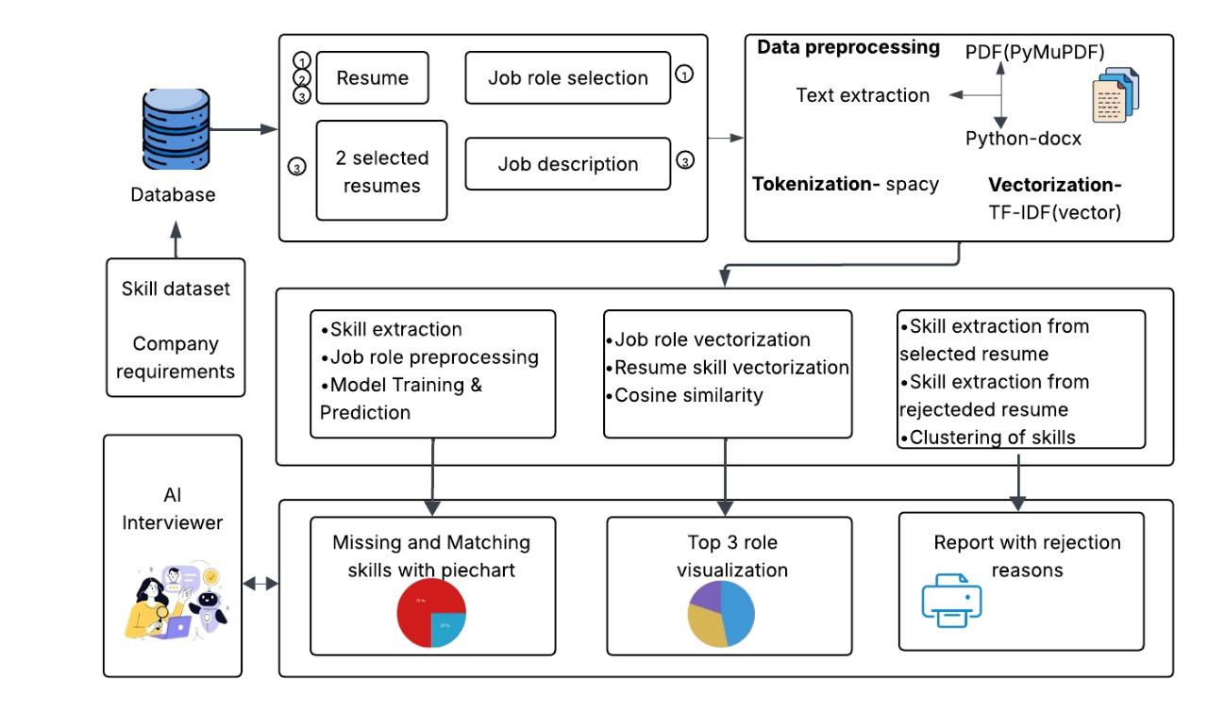
Architecture(framework)

Slide 7
Module 1 : Skill Gap Detection
This module identifies the gap between a candidate’s skills and the skills required for a job role. Resumes in PDF or DOCX format are extracted using PyMuPDF and python-docx, then cleaned and processed with spaCy.
Skills are converted into TF-IDF vectors and compared with job role descriptions using cosine similarity to find matched and missing skills.
The results are shown through pie charts and bar graphs, giving candidates a clear view of their strengths and areas that need improvement.

Slide 8
Module 2 : Candidate Fitment Analysis
The second module predicts and ranks the most suitable job roles for each candidate based on their skill set. Both resume data and job role descriptions are converted into numerical vectors using TF-IDF. Cosine similarity is applied to measure the degree of alignment between candidate skills and job requirements.
The top-ranked job recommendations are displayed through bar charts, helping candidates visualize how closely they match different positions. This module ensures data-driven job role recommendations that guide candidates toward roles best aligned with their capabilities.

Slide 9
Module 3 : Resume Rejection Reasoning
The third module aims to provide clarity on why certain resumes are rejected while others are selected for the same job role. Using spaCy, the resumes are tokenized, cleaned, and categorized into technical, soft, and domain-specific skill groups.
A comparative analysis is then performed between selected and rejected resumes using cosine similarity or the Jaccard index to identify key skill deficiencies or missing qualifications. The insights are visualized which illustrate rejection causes and highlight areas for improvement. This module provides candidates with transparent feedback and actionable insights, helping them enhance their profiles and increase their chances of selection in future applications.

Slide 10
Module 4 : AI Interviewer
The fourth module acts as a virtual interviewer, designed to simulate AI-based interview sessions tailored to each candidate’s profile and target role. It analyzes resume content and job role data to identify relevant technical and behavioral areas. Based on this, the system generates customized interview questions using AI-driven templates.
Candidates then engage in an interactive simulation, where their responses are evaluated through NLP-based scoring models that assess accuracy, confidence, and relevance. Finally, visual performance reports display overall feedback and improvement areas.

Slide 11
Conclusion
This project successfully integrates NLP and machine learning to create a complete, AI-driven resume analysis and career guidance system. By detecting skill gaps, evaluating job fitment, explaining rejection reasons, and generating personalized interview questions, the system offers a transparent and structured approach to career readiness. It not only helps students and job seekers understand where they stand but also guides them with actionable insights for improvement. The combined modules make the platform a powerful tool for enhancing employability, supporting informed decision-making, and preparing candidates more effectively for real-world opportunities.

Slide 12
Thank You

